Slide 1
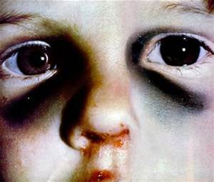
Physical Abuse
CAST 301
Chapter 4
Dr. Edwards

Slide 2
Physical Abuse
Definition?
Prevalence and Incidence
Corporal Punishment
  Confusion…
  Pros and cons
Case Studies and discussion questions
  How would you respond?
https://www.youtube.com/watch?v=z8vZxDa2KPM

Slide 3
Consequences of p.a.
Immediate medical/health problems are the most obvious
  Bruises – most common physical injury associated with P.A.
    Assessment and concerns?
      Age, body parts (where?), pattern, timing, bite marks
  Fractures
    Primary care physician
    Common at what age? Ask questions! What is parent’s story?
  Head injuries
    Occult H.I.?
  SBS
    Signs and symptoms

Slide 4
Consequences continued
  Injuries from falls
    What does the research say?
  Burns
    Who? How hot? “glove or sock burns”, pattern burns
  Death
    1560 children died from maltreatment in 2010
      41% had more than one form of maltreatment
      Neglect (33%), PA (23%),
      Younger than one (48%), Younger than four (80%)
Not all marks are signs of abuse!!

Slide 5
Nonphysical consequences of P.A.
Intellectual and Academic Problems
Cognitive Processing
  Low empathy
Interpersonal relationships
  Resistant/avoidant attachment weak foundation for future relationships
  Deficient in some prosocial behaviors
Aggression
  Modeled as a way to solve problems and an appropriate behavior
Substance Abuse

Slide 6
Continued Nonphysical consequences
Internalizing symptoms
  Victims of physical abuse are more likely to show signs of ____ than those who have not been victims of P.A.
    Suicide – 14th leading cause of death vs. 3rd leading cause of death
PTSD
  What does the DSM say?
Others
  Increased risk for ___

